Slide 1

Subject: Database Management System
Subject Code:BCS403
Semester : 4
Course Instructors: Prof.Komala Devi,Prof.Abdul Kather, Prof.Jhanvi
Department of Information Science and Engineering,
CMRIT – Bangalore.

Slide 2
DBMS - Module 2
Relational Model Concepts
Relational Model Constraints
Relational Database Schemas
Update operations, Transactions and dealing with constraint violation
Relational Algebra: Unary and Binary relation operations
Additional relational operations (aggregate, grouping, etc)
Example queries in Relational algebra
Relational database design using ER-to-relational mapping

Slide 3
SQL: Data definition and data types, specifying constraints in SQL
Retrieval queries in SQL
Insert, Delete, and update statement in SQL
Additional features of SQL

Slide 4
Introduction
The table is called relation (or) simply, a table is a collections of related attributes and there is a relation among the attributes.
The relational model is today the primary data model for commercial data processing applications.
A relational database consists of a collection of tables, each of which is assigned a
unique name.
a row in a table represents a relationship among a set of values. Since a table is a collection of such relationships, there is a close correspondence between the concept of table and the mathematical concept of relation, from which the relational data model takes its name.
Thus, in the relational model the term relation is used to refer to a table, while the term tuple is used to refer to a row. Similarly, the term attribute refers to a column of a table.

Slide 5
Relational Model Concepts
Definition 1:
Relational model can represent as a table with columns and rows. Each row is known as a tuple. Each table of the column has a name or attribute.
  Domain: It contains a set of atomic values that an attribute can take
  Attribute: It contains the name of a column in a particular table. Each attribute Ai must have a domain, dom(Ai)
Definition 2:
RELATIONAL MODEL (RM) represents the database as a collection of relations.
  A relation is nothing but a table of values. Every row in the table represents a collection of related data values. These rows in the table denote a real-world entity or relationship.
  In the relational model, data are stored as tables. However, the physical storage of the data is independent of the way the data are logically organized.

Slide 6
In relational model, the data and relationships are represented by collection of inter-related tables. Each table is a group of column and rows, where column represents attribute of an entity and rows represents records

Slide 7
Domain, Attributes, Tuples, and Relations
Domain
A Domain D is a set of atomic values. Atomic mean each value in the domain is indivisible.
Domain can be specified by data type from the which the data values forming the domain.
Data type and format also specified.
Specify the name for the domain – It will be useful.
E.g, Phone_number;
Aadhar_number; etc.,

Slide 8
Attribute Types
Each attribute of a relation has a name
The set of allowed values for each attribute is called the domain of the attribute
Attribute values are (normally) required to be atomic; that is, indivisible
  E.g. multivalued attribute values are not atomic
  E.g. composite attribute values are not atomic
The special value null is a member of every domain. Indicated that the value is “unknown”
The null value causes complications in the definition of many operations
  we shall ignore the effect of null values in our main presentation and consider their effect later

Slide 9
Relation Name
Attributes
Student
Tuples
Name | SSN | Home_Phone | Address | Office_Phone | Age
Marx | 1001 | 42345 | 12 Germany | 4857474 | 65
Lenin | 1201 | 42356 | 34 Masco | 48456594 | 53
Stalin | 2313 | 34848 | 23 Russia | 475648 | 64

Slide 10
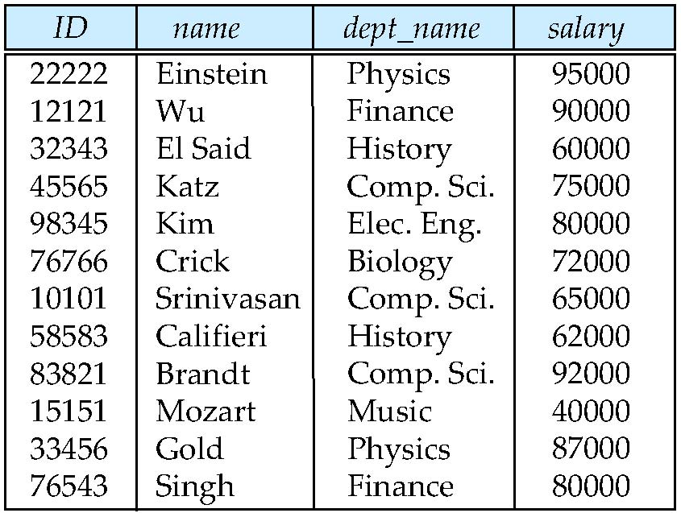
Relations are Unordered
Order of tuples is irrelevant (tuples may be stored in an arbitrary order)
Example: instructor relation with unordered tuples

Slide 11
Ordering of Tuples in a Relation
A relation is defined as a set of tuples. Mathematically, elements of a set have no order among them, hence, tuples in a relation do not have any particular order.
Tuples ordering is not part of a relation definition because a relation attempts to represent facts at logical or abstract level.

Slide 12
Ordering of Values within a Tuple and an Alternative definition of a relation
  A Relation Schema R={A1, A2,…….An} is a set of attributes and a relation state r(R) is a finite set of mappings r={t1,t2,….tm}, where each tuple ti is a mapping from R to D, and D is the union of attribute domains; that is D= dom(A1) U dom(A2) U Dom(A3) U….U Dom(An).
  Here, a tuple can be considered as a set of (<attribute>, <value>) pair, where each pair gives the value of the mapping from an Attribute Ai to a value Vi from dom(Ai). Ordering of attribute is not important, because the attribute name appears with its value.

Slide 13
Values and NULLs in the Tuples
Each value in a tuple is an atomic value. – It is not divisible into component.
Composite and multivalued attributes are not allowed. This model is sometime called as flat relation model. (First Normal Form)
Null Values, used to represent the values of attributes that may be unknown or may not apply to a tuple. A Special value, called NULL, can be used in this case.

Slide 14
Interpretation(Meaning) of a Relation
A relation schema (table) can be interpreted as a declaration or a type of assertion. Eg., Student relation, (student table or entity) has a name, ssn, home_phone, address, office_phone, and age.
Note: Some relations may represent fact about entities: whereas other relation may represent fact about relationships.

Slide 15
Relational Model Constraints and Relational Database Schemas
In relational database, there will typically be many relations, and the tuples in those relations are related in many ways.
The state of the whole database will correspond to the states of all its relations at a particular point in time.
There are many restrictions or Constraints on the actual values in a database state.
  Constraints that are inherent in the data model is called inherent model based constraints or implicit constraints.
  Constraints that can be directly expressed in the schemas of the data model – specifying them in DDL (while creating table), - Schema based Constraints or Explicit Constraints.

Slide 16
Constraints that cannot be directly expressed in the schemas of the data model, and hence must be expressed and enforced by the application programs or in some other way. This is called application-based or Semantic constraints or Business rules.

Slide 17
Every relation has some conditions that must hold for it to be a valid relation. These conditions are called Relational Integrity Constraints. There are three main integrity constraints −
Key constraints
Domain constraints
Referential integrity constraints
Key Constraints
There must be at least one minimal subset of attributes in the relation, which can identify a tuple uniquely. This minimal subset of attributes is called key for that relation. If there are more than one such minimal subsets, these are called candidate keys.

Slide 18
In a relation with a key attribute, no two tuples can have identical values for key attributes.
A key attribute can not have NULL values. Key constraints are also referred to as Entity Constraints
The data values stored in the database must satisfy certain consistency constraints
Eg., Account balance of a department must never be negative.
DDL provides facilities to specify such constraints. The database system checks these constraints every time the database is updated
Domain Constraints
Attributes have specific values in real-world scenario. For example, age can only be a positive integer. The same constraints have been tried to employ on the attributes of a relation. Every attribute is bound to have a specific range of values. For example, age cannot be less than zero and telephone numbers cannot contain a digit outside 0-9.

Slide 19
Domain Constraints: A domain of possible values must be associated with every attribute (for example, integer types, character types, date/time types). Declaring an attribute to be of a particular domain acts as a constraint on the values that it can take.
Referential integrity Constraints
Referential integrity constraints work on the concept of Foreign Keys. A foreign key is a key attribute of a relation that can be referred in other relation. Referential integrity constraint states that if a relation refers to a key attribute of a different or same relation, then that key element must exist.

Slide 20
Referential Integrity: There are cases where we wish to ensure that a value that appears in one relation for a given set of attributes also appears in a certain set of attributes in another relation
Assertions: An assertion is any condition that the database must always satisfy. Domain constraints and referential-integrity constraints are special forms of assertions.

Slide 21
Relational Database Schema
When we talk about a database, we must differentiate between the database schema, which is the logical design of the database, and the database instance, which is a snapshot of the data in the database at a given instant in time.
A database consists of multiple relations
Information about an enterprise is broken up into parts, with each relation storing one part of the information, some examples follows:
• student (ID, name, dept name, tot cred)
• advisor (s id, i id)
• takes (ID, course id, sec id, semester, year, grade)
• classroom (building, room number, capacity)
• time slot (time slot id, day, start time, end time)

Slide 22
Relationship Sets
A relationship is an association among several entities. For example, we can define a relationship advisor that associates instructor Katz with student Shankar. This relationship specifies that Katz is an advisor to student Shankar.
relationship set is a set of relationships of the same type. Formally, it is a mathematical relation on n ≥ 2 (possibly nondistinct) entity sets. If E1, E2, . . . , En. are entity sets, then a relationship set R is a subset of
{(e1, e2, . . . , en) | e1 ∈ E1, e2 ∈ E2, . . . , en ∈ En}
where (e1, e2, . . . , en) is a relationship.
Attributes: For each attribute, there is a set of permitted values, called the domain, or value set, of that attribute.
attribute types are:
Simple and composite attributes.
Single-valued and multivalued
Derived attribute.

Slide 23
Referential Integrity: We wish to ensure that a value that appears in one relation for a given set
of attributes also appears for a certain set of attributes in another relation. This condition is called referential integrity.
Foreign keys can be specified as part of the SQL create table statement by using the foreign key clause.
let r1 and r2 be relations whose set of attributes are R1 and R2, respectively, with primary keys K1 and K2. We say that a subset of R2 is a foreign key referencing K1 in relation r1 if it is required that, for every tuple t2 in r2, there must be a tuple t1 in r1 such that t1.K1 = t2.
Requirements of this form are called referential-integrity constraints, or subset dependencies.

Slide 24
Relation Schema and Instance
A₁, A₂, …, A_{n} are attributes – Eg., USN, Name, Address, Mobile_NO
R = (A₁, A₂, …, A_{n} ) is a relation schema - Student(USN, Name, Address, Mobile_No)
Create table student(USN Varchar(10), Name varchar(20), Address varchar (40), Mobile_No number(10));
Example: instructor = (ID, name, dept_name, salary)
Formally, given sets D₁, D₂, …. D_{n} a relation r is a subset of
D₁ x D₂ x … x D_{n}
Thus, a relation is a set of n-tuples (a₁, a₂, …, a_{n}) where each a_{i} ∈ D_{i}
The current values (relation instance) of a relation are specified by a table
An element t of r is a tuple, represented by a row in a table

Slide 25
BASIC STRUCTURE
Formally, given sets D1, D2, …. Dn a relation r is a subset of D1 x D2 x … x Dn
Thus a relation is a set of n-tuples (a1, a2, …, an) where each ai ∈ Di
Example: if
customer-name = {Jones, Smith, Curry, Lindsay}
customer-street = {Main, North, Park}
customer-city = {Harrison, Rye, Pittsfield}
Then r = { (Jones, Main, Harrison),
(Smith, North, Rye),
(Curry, North, Rye),
(Lindsay, Park, Pittsfield)} is a relation over customer-name x customer-street y customer-city z

Slide 26
A Relational Schema ‘s’ is a set of relational schemas S={R1, R2,….Rn} and set of integrity constraints IC.
A Relational database state DB of S is a set of relation states DB={r1,r2,….rn} such that each ri is a state of Ri and such that the relation ri relation state specify integrity constraints specified in IC.
Relational Database Schema – Company
Company = {EMPLOYEE, DEPARTMENT, DEPT_LOCATIONS, PROJECT, WORKS_ON, DEPENDENT}
When we refer to a relational database, we implicitly include both its schema and its current state.

Slide 27
EMPLOYEE
Fname | Minit | Lname | SSN | Bdate | Address | Sex | Salaey | Super_ssn | Dno
DEPARTMENT
Dname | Dnumber | Mgr_ssn | Mgr_start_date
DEPT_LOCATIONS
Dnumber | Dlocation
PROJECT
Pname | Pnumber | Plocation | Dnum
WORKS_ON
Essn | Pno | Hours
DEPENDENT
Essn | Dependent_name | Sex | Relationship

Slide 28
Keys
Let K ⊆ R
K is a superkey of R if values for K are sufficient to identify a unique tuple of each possible relation r(R)
  Example: {ID} and {ID,name} are both superkeys of instructor(Relation or Table).
Superkey K is a candidate key if K is minimal. Example: {ID} is a candidate key for Instructor
One of the candidate keys is selected to be the primary key. which one?
Foreign key constraint: Value in one relation must appear in another
  Referencing relation
  Referenced relation
  Example – dept_name in instructor is a foreign key from instructor referencing department

Slide 29
Super Key: One or more attributes used to identify the record from record set is called super key.
Candidate Key: Minimal sub-set of super key is called candidate key
Primary Key: The Database Admin can assign any one of the candidate key as ‘Primary key’.
Foreign key: The value in one relation must appear in another relation.

Slide 30
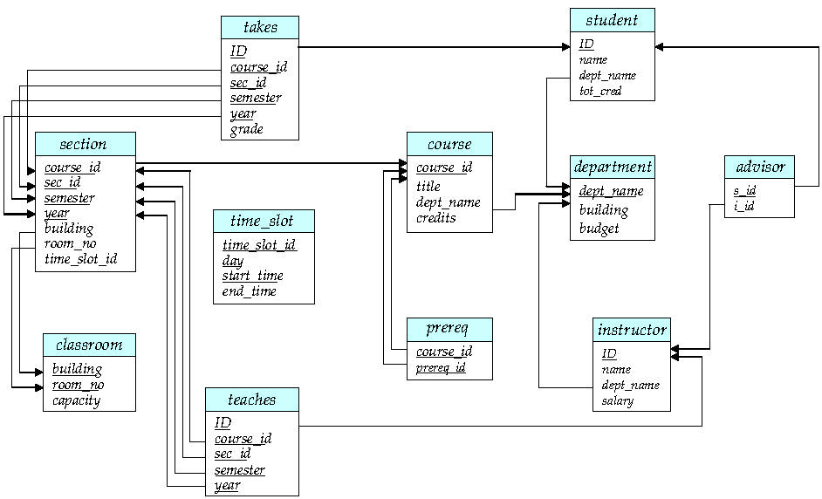
Schema Diagram for University Database

Slide 31
Entity Integrity, Referential Integrity, and Foreign Keys
The entity integrity constraint states that no primary key value can be NULL.
This is because the primary key value is used to identify individual tuples in a relation.
Having NULL values for the primary key implies that we cannot identify some tuples.
Key constraints and entity integrity constraints are specified on individual relations.
The referential integrity constraint is specified between two relations and is used to maintain the consistency among tuples in the two relations.

Slide 32
Update Operations, Transactions, and
Dealing with Constraint Violations
The Insert operation provides a list of attribute values for a new tuple t that is to be inserted into a relation R.
Insert can violate any of the four types of constraints.
Domain constraints can be violated if an attribute value is given that does not appear in the corresponding domain or is not of the appropriate data type.
Key constraints can be violated if a key value in the new tuple t already exists in another tuple in the relation r(R).
Entity integrity can be violated if any part of the primary key of the new tuple t is NULL.
Referential integrity can be violated if the value of any foreign key in t refers to a tuple that does not exist in the referenced relation.

Slide 33
The Delete operation can violate only referential integrity. This occurs if the tuple being deleted is referenced by foreign keys from other tuples in the database. To specify deletion, a condition on the attributes of the relation selects the tuple (or tuples) to be deleted.
The Update (or Modify) operation is used to change the values of one or more attributes in a tuple (or tuples) of some relation R. It is necessary to specify a condition on the attributes of the relation to select the tuple (or tuples) to be modified.

Slide 34
Update Operations
In certain situations, we may wish to change a value in a tuple without changing all values in the tuple. For this purpose, the update statement can be used. As we could for insert and delete, we can choose the tuples to be updated by using a query.
Suppose that annual salary increases are being made, and salaries of all instructors are to be increased by 10 percent. We write:
update instructor set salary= salary * 10.05;
Updating an attribute that is neither part of a primary key nor part of a foreign key usually causes no problems; the DBMS need only check to confirm that the new value is of the correct data type and domain. Modifying a primary key value is similar to deleting one tuple and inserting another in its place because we use the primary key to identify tuples.

Slide 35
Transactions Concepts
A database application program running against a relational database typically executes one or more transactions.
A transaction is an executing program that includes some database operations, such as reading from the database, or applying insertions, deletions, or updates to the database.
At the end of the transaction, it must leave the database in a valid or consistent state that satisfies all the constraints specified on the database schema.
A transaction consists of a sequence of query and/or update statements. The SQL standard specifies that a transaction begins implicitly when an SQL statement is executed.

Slide 36
One of the following SQL statements must end the transaction:
Commit work: commits the current transaction; that is, it makes the updates performed by the transaction become permanent in the database. After the transaction is committed, a new transaction is automatically started.
Rollback work: causes the current transaction to be rolled back; that is, it all the updates performed by the SQL statements in the transaction. Thus, the database state is restored to what it was before the first statement of the transaction was executed.
Transaction rollback is useful if some error condition is detected during execution of a transaction
Once a transaction has executed commit work, its effects can no longer be undone by rollback work

Slide 37
Relation Algebra
The relational algebra defines a set of operations on relations, paralleling the usual algebraic operations such as addition, subtraction or multiplication, which operate on numbers
Relation Algebra
Unary Binary
- Select - Union
- Project - Intersection
- Rename - Differences
- Cartesian Product
Aggregate Function
Find all the loans of over 1200
σ amount >1200(loan)
SQL> select *from loan where amount>1200;

Slide 38
The basic set of operations for formal relation model is the relational algebra.
Those operations enable a user to specify basic retrieval requests knows as relational algebra expression.
The result of the retrieval query is a new relation.
The algebra operations thus produces new relation, which can be further manipulated using operations of the same algebra.

Slide 39
The algebra defines a set of operations for the relational model
The relational calculus provide a higher level declarative language for specifying relational query.

Slide 40
Select Operation
The select operation selects tuples that satisfy a given predicate. The Select operation is used to select subset of the tuples from relation that satisfies the selection condition.
Notation: σ p(r)
p is called the selection predicate
Defined as:
σ p(r) = {t | t ∈ r and p(t)}
Where p is a formula in propositional calculus consisting of terms connected by : ∧ (and), ∨ (or), ¬ (not)
The Select operating is commutative
σ<cond1>(σ<cond 2>(R))= σ<cond 2>(σ<cond 1>(R))

Slide 41
σDno=4(EMPLOYEE)
σsalary>30000(EMPLOYEE)
Each term is one of: <attribute> op <attribute> or <constant>
where op is one of: =, ≠, >, ≥. <. ≤
Example of selection:
σ branch-name=“Perryridge”(account)

Slide 42
Thus, to select those tuples of the loan relation where the branch is “Perryridge,” we write
SQL>σ branch-name = “Perryridge” (loan)
We can find all tuples in which the amount lent is more than $1200 by writing
SQL>σ amount>1200 (loan)
find those tuples pertaining to loans of more than $1200 made by the Perryridge branch, we write
SQL> σ branch-name = “Perryridge” ∧ amount>1200 (loan)
The Project Operation
we write the query to list all loan numbers and the amount of the loan as
SQL>Π loan-number, amount(loan)

Slide 43
Composition of Relational Operations
The fact that the result of a relational operation is itself a relation is important. Consider the more complicated query “Find those customers who live in Harrison.” We write:
SQL> Π customer-name (σ customer-city = “Harrison” (customer ))
The Union Operation
how to find the names of all customers with a loan in the bank
SQL> Π customer-name (borrower)
and
SQL> Πcustomer-name (depositor)
SQL> Πcustomer-name (borrower ) ∪ Πcustomer-name (depositor)

Slide 44
Find the loan number for each loan for an amount greater then 1200
π loan_number(σ amount>1200) (loan))
SQL> select loan_number from loan where amount >1200;
Find the names of all customer who have a loan, an account, or both from the bank
π customer_name(borrower) U π customer_name(depositor)
SQL> select customer_name from borrower
union
select customer_name from depositor

Slide 45
Find the names of all customer who have a loan and an account at bank
π customer_name (borrower) ∩ π customer_name(depositor)
SQL> select customter_name from borrower intersect select customer_name from depositor;

Slide 46
The Project Operation
The project operation is a unary operation that returns its argument relation, with certain attributes left out.
Suppose we want to list all instructors’ ID, name, and salary, but do not care about the dept name. Projection is denoted by the uppercase Greek letter pi (π)
The result is defined as the relation of k columns obtained by erasing the columns that are not listed
Duplicate rows removed from result, since relations are sets
Example
π ID, name, salary (instructor )

Slide 47
Example
To find the set of all courses taught in the Fall 2009 semester, we
write:
π course id (semester =“Fall”∧ year=2009 (section))
To find the set of all courses taught in the Spring 2010 semester, we write:
π course id (semester =“Spring”∧year=2010 (section))
To answer the query, we need the union of these two sets; that is, we need all section IDs that appear in either or both of the two relations. We find these data binary operation union, denoted, as in set theory, by ∪. So the expression
needed is:
course id (semester =“Fall”∧ year=2009 (section)) ∪ course id (semester =“Spring” ∧ year=2010 (section))

Slide 48
Find the names of all customers who have loan at the bank and find the amount of the loan;
Find the names of all branches with customer who have an account in the bank and who lives in “Harrison”.
Division Operation
Find all customer who have an account at all the branches located in ‘Brooklyn’.
Aggregate Function
> Find the average account balance at the ‘Perryridge’ branch.
> Find the average account balance at each branch.
> Find the No. of depositor for each branch.
> Find the branches where the average account balance is more than 1200
> Find the average balance for each customer who lives in “Harrison” and has at least three account

Slide 49
Nested Queries
Find all customers who have both a loan and an account.
Find all customers who have both an account and a loan at the ‘Perryridge’ branch.
Find all customer who do have a loan at the bank, but do not have an account at the bank.
Select names of customer who have a loan at the bank and where names are neither “Smith” nor “Jones”.
Find the names of all the branches that have assets greater than those of at least one branch located in “Brooklyn”
Find the branch that has the highest average balance.

Slide 50
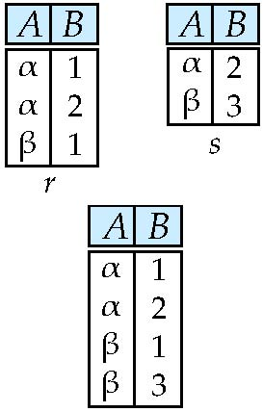
The Union Operation
Relations r, s:
r ∪ s:

Slide 51
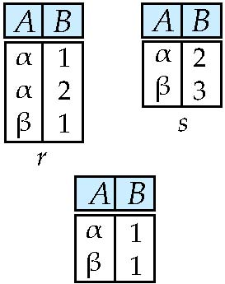
Set difference of two relations
Relations r, s:
r – s

Slide 52
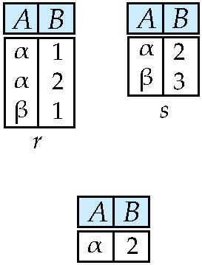
Set intersection of two relations
Relation r, s:
r ∩ s
Note: r ∩ s = r – (r – s)

Slide 53
The Set Difference Operation
find all customers of the bank who have an account but not a loan
SQL> Πcustomer-name (depositor) − Πcustomer-name (borrower)

Slide 54
The following command creates a relation department in the database.
create table department (dept name varchar (20), building varchar (15), budget numeric (12,2), primary key (dept name));
Queries: “Find the names of all instructors.”
The instructor’s name appears in the name attribute, so we put that in the select clause.
select name from instructor;
Example query: “Find the department names of all instructors,”
select dept name from instructor ;

Slide 55
The select clause is used to list the attributes desired in the result of a query.
• The from clause is a list of the relations to be accessed in the evaluation of the query.
• The where clause is a predicate involving attributes of the relation in the from clause.
A typical SQL query has the form
select A1, A2, . . . , An
from r1, r2, . . . , rm
where P;

Slide 56
Aggregate Functions
Aggregate functions are functions that take a collection (a set or multiset) of values as input and return a single value. SQL offers five built-in aggregate functions:
• Average: avg
• Minimum: min
• Maximum: max
• Total: sum
• Count: count
Basic Aggregation
Consider the query “Find the average salary of instructors in the Computer Science department.” We write this query as follows:
select avg (salary) from instructor where dept name= ’Comp. Sci.’;

Slide 57
An example arises in the query “Find the total number of instructors who teach a course in the Spring 2010 semester.”
select count (distinct ID)
from teaches where semester = ’Spring’ and year = 2010;
consider the query “Find the average salary in each department.” We write this query as follows:
select dept name, avg (salary) as avg salary
from instructor group by dept name;
consider the query “Find the average salary of all instructors.” We write this query as follows:
select avg (salary) from instructor;

Slide 58
Referential Integrity
USN (PK) | Name | DOB | Address | Phone
1mj18is1 | Abc | 12 | Dfkdj | 12541
1mj18is2 | Def | 12 | Doierj | 13256
1mj18is3 | ghi | 21 | xxcns | 65238
Sport No | S_name | USN | Name | Date
100 | X | 1mj18is1 | Abc
200 | Y | 1mj18is2 | Def
300 | z | 1mj18is3 | ghi

Slide 59
Relational database design using ER-to-relational mapping
Entity-Relationship Model. The entity-relationship (E-R) data model uses a collection of basic objects, called entities, and relationships among these objects. An entity is a “thing” or “object” in the real world that is distinguishable from other objects. The entity-relationship model is widely used in database design.
The entity-relationship (E-R) data model was developed to facilitate database design by allowing specification of an enterprise schema that represents the overall logical structure of a database.
The E-R model is very useful in mapping the meanings and interactions of real-world enterprises onto a conceptual schema.
The E-R data model employs three basic concepts: entity sets, relationship sets, and attributes.

Slide 60
Basic SQL
SQL uses the term table, row, and column for the formal relational model terms relation, tuple, and attribute.
The Concept of SQL Schema – grouping together tables and other constructs that belongs to the same database applications. (Schema is called database)
SQL schema is identified by the schema name and includes an authorization identification.
The schema can be create via create schema statement.
Eg., create schema employee authorization ‘IseDepartment’;
create user employee identified by ‘IseDepartment’;

Slide 61
catalog – Collection of schemas.
SQL
SQL
Data Definition Language
Data Manipulation Language

Slide 62
SQL - Data Definition and Data Types
CREATE TABLE command
create table company(Fname varchar(15) not null, Minit char, Lname varchar(15) not null, Ssn char(9) not null, Bdate date, Address varchar(30), Gender char, Salary decimal(10,2), Super_ssn char(9), Dno int not null, primary key(Ssn);
SQL> create table student (usn varchar(10), name varchar(15), course varchar(3), phone number(10));

Slide 63
SQL: Data definition and data types
Integrity Constraints: Integrity constraints ensure that changes made to the database by authorized users do not result in a loss of data consistency.
Examples of integrity constraints are:
• An instructor name cannot be null.
• No two instructors can have the same instructor ID.
• Every department name in the course relation must have a matching department name in the department relation.
• The budget of a department must be greater than $0.00.
Constraints on a Single Relation:
• not null
• unique
• check(<predicate>)

Slide 64
Attribute Data types and Domains in SQL
Numeric Data Types
* int, smallint, float or real, and double precision.
* Formatted numbers can be declared by decimal( i, j) or dec(i, j) or number(i, j)
Character String
* char(n) or character(n), varchar(n)
Bit String
*
Boolean – has the traditional value of true or false

Slide 65
Date – date – YYY-MM-DD(Year, Month, and Day), and the Time data type HH:MM:SS(Hour, Minutes, and Second)

Slide 66
Insert, Delete, and update statement in SQL
To insert data into a relation, we either specify a tuple to be inserted or write a Query whose result is a set of tuples to be inserted.
insert into course
values (’CS-437’, ’Database Systems’, ’Comp. Sci.’, 4);
(OR)
insert into course (course id, title, dept name, credits)
values (’CS-437’, ’Database Systems’, ’Comp. Sci.’, 4);
In certain situations, we may wish to change a value in a tuple without changing all values in the tuple. For this purpose, the update statement can be used.
Suppose that annual salary increases are being made, and salaries of all instructors are to be increased by 5 percent. We write:
update instructor set salary= salary * 1.05;

Slide 67
Text books and Reference books
Text Books
1. | Fundamentals of Database Systems, Ramez ElmasriandShamkantB.Navathe,7thEdition,2017,Pearson. ISBN: 978-0-13-397077-7
2. | Databasemanagementsystems,Ramakrishnan,andGehrke,3rdEdition,2014, McGrawHill ISBN-10: 0072465638
Reference Books
 | Silberschatz Korth and Sudharshan, Database System Concepts, 6th Edition,Mc-GrawHill,2013. ISBN-10: 9332901384
2. | Coronel, Morris, and Rob, Database Principles Fundamentals of Design, Implementation and Management, Cengage Learning2012. ISBN 9781285196145

Slide 68
Some useful links
https://www.cs.uregina.ca/Links/class-info/215/erd/#:~:text=Data%20modeling%20is%20a%20technique,data%20requirements%20for%20a%20database
https://www.geeksforgeeks.org/generalization-specialization-and-aggregation-in-er-model/
https://www.guru99.com/relational-data-model-dbms.html
https://www.tutorialspoint.com/dbms/relational_algebra.htm

Slide 69
Thank You

